Slide 1
Quiz on Algorithm Analysis and Big-O
CS105 A 2nd Semester, SY17-18

Slide 2
Categorize to Big-O Notation
Example: f(n) = 5n -> O(n)
f(n) = 3n³ + 4n + 3.1416
f(n) = 45n + 34n² + log n
f(n) = 15 + 17n² + 2^{n}
f(n) = 69
f(n) = n log n + n + log n
Notes:
N3 n2 2n 1 n log n

Slide 3
Count the number of Primary Operations
6. int [ ] a = {5, 12, 6 - 5, 2}
7. if currentMax < a[2]
8. for i <- 1 to n do
Notes:
2, 2, 4

Slide 4
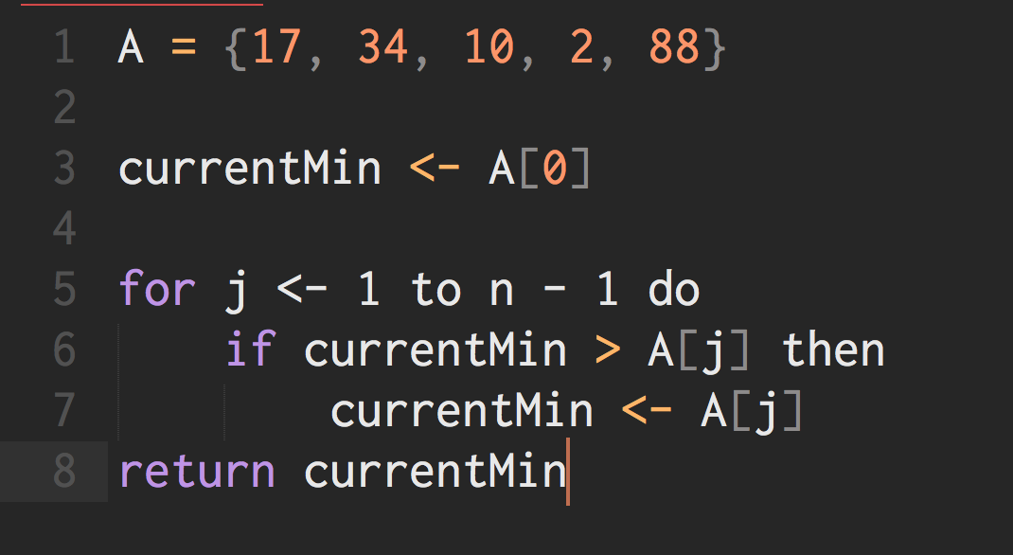
9. How many operations does this code block have?
10. What is the Big-O classification?
Notes:
34, 69, 777, 17, 23

Slide 5
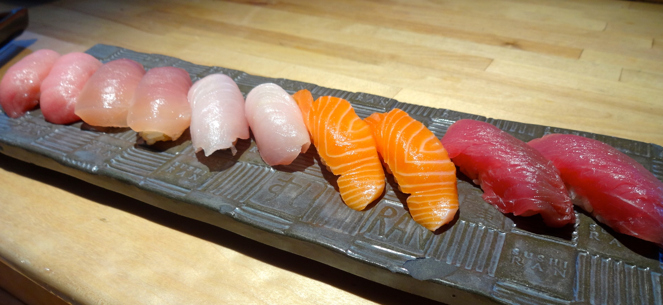
Bonus Round
11. What kind of sushi is this?

Slide 6

Bonus Round
12. What’s the name of this SpaceX rocket?

